Slide 1
PREPARING
FOR
GROUP DISCUSSIONS

Slide 2
Some of the personality traits the GD is trying to gauge may include:
Communication skills | Interpersonal skills
Leadership skills | Motivational skills
Team building skills | Analytical skills
Reasoning skills | Different thinking
Initiative | Assertiveness
Flexibility | Creativity

Slide 3
Process of Group Discussion
8-10 students are taken as a group, though in some cases, up to 16 people may be included in a group. The GD lasts for 10-15 minutes.
For a topic-based GD, 2-3 minutes of thinking time may be given; though the group is often told to start right away. For case studies, however, about 15 minutes is given.
Evaluation is done by experts, usually professors from B-School. These people are experts and observe all details, even if the GD is chaotic.
Candidates may be seated in a circle or in a rectangular arrangement, with/out a table. Seating arrangements may be prefixed.
Discussion may be stopped at the set time / even earlier. Conclusion may be asked for. summary may be asked for at the end from each candidate.

Slide 4
Types of GDs
Topic given -- Time given
Topic not given -- time is given
Topic given -- time is given
Evaluator assigns a person to initiate, and assigns a person to conclude and everyone gets one min to talk
4. Sometimes topic given -- time is not given(becomes extempore round)

Slide 5
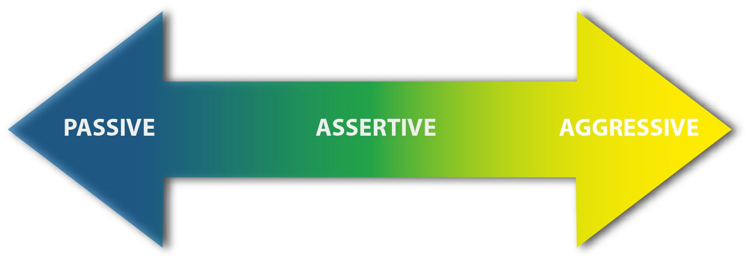
TYPES OF CANDIDATES

Slide 6
Types of topics
Factual | Controversial | Abstract
Are about practical things, which an ordinary person is aware of. | Are argumentative in nature and are meant to generate controversy. | Are about intangible things.
Typically these are socio-economic topics which may have been in the news lately, or could be unbound by time. | Objective is to see how much maturity the candidate displays by keeping his temper in check, by rationally and logically arguing his point of view without getting personal and emotional. | Usually not given often for discussion, but their possibility cannot be ruled out. Objective is to test your lateral thinking and creativity.
E.g. The Education Policy of India, Tourism in India, LokPal Bill | E.g. Reservations should be removed, Women make better managers. | E.g. A is an alphabet, Twinkle twinkle little star, The number 10.

Slide 7
Preparing for group discussions
STEP
S – Social/scientific
T – Technology
E – Economy/Education/Environment
P – Political/ Psychological

Slide 8
Preparing for group discussions
WHY
WHAT
WHO
HOW
WHERE
WHEN

Slide 9
Presenting the group discussions
PREP
Point
Reason
Example
Point

Slide 10
Preparing for group discussions
K A S H Strategies.
K – KNOWLEDGE
Social awareness
Knowledge in current affairs.
National and international issues.
A – Attitude
Set your goal – plan actions
Winning attitudes
Continuing learning.
Practice skills

Slide 11
Preparing for group discussions
K A S H Strategies.
S - Skills
Develop through practice
Presentation skills
Communication Skills
Non-verbal skills
H – Habits
all through your efforts(Discipline)
Admit your mistakes
Learn from mistakes

Slide 12
EVALUATION
FOR
GROUP DISCUSSIONS.
HOW ARE YOU EVALUATED IN YOUR GROUP DISCUSSIONS?
Personality
Communication Skills
Knowledge
Leadership and teamwork

Slide 13
EVALUATION
FOR
GROUP DISCUSSIONS.
HOW ARE YOU EVALUATED IN YOUR GROUP DISCUSSIONS?
Personality
Smartness – dress – smile on the face
Cheerfulness – free from tensions and nervousness
Enthusiasm – attitude of taking that one step extra

Slide 14
EVALUATION
FOR
GROUP DISCUSSIONS.
HOW ARE YOU EVALUATED IN YOUR GROUP DISCUSSIONS?
Communication Skills
Fluency – not speed. But poise and right word in the right place
Clarity – Effectiveness of the message
Logic – the presentation skill

Slide 15
EVALUATION
FOR
GROUP DISCUSSIONS
HOW ARE YOU EVALUATED IN YOUR GROUP DISCUSSIONS?
Knowledge
Relevance – Topic related
Depth – in and out of the subject. Factual info and data

Slide 16
EVALUATION
FOR
GROUP DISCUSSIONS
HOW ARE YOU EVALUATED IN YOUR GROUP DISCUSSIONS?
Leadership
Initiative – taking the lead. Breaking the ice. Being in the forefront.
Team Spirit. – ability to work with people. Cooperation and consolidation.

Slide 17
Do’s & Don’ts of Group Discussion
Do’s
Respect the contribution of other speakers.
Speak pleasantly.
Listen well to the ideas of other speakers; you will learn something.
Learn to disagree politely.
Respect that others have differing views.
Think about your contribution before you speak.
Try to stick to the discussion topic.
Your body language should be `open' & friendly.
Agree & acknowledge anything interesting.
Stay with the topic. If the discussion does waiver, bring it back on topic by saying `that's an interesting point, can we come back to that later?
Try to speak clearly. Don't whisper.
Don’ts
Don't take offence if a person disagrees with you.
Don't ridicule the contribution of others by using comments like `that's stupid', that's ridiculous, or `you're wrong'.
Don't try to intimidate another speaker.
Don't use a loud or angry tone. Others will not want to listen to you if you are being aggressive.
Don't use aggressive gestures like finger-pointing and table-thumping.
Try not to dominate the discussion. Confident speakers should allow others a chance to speak.
Avoid drawing too much on personal experience.
Don't interrupt or talk over another speaker. Listening to others earns you the right to be heard.

Slide 18
Some Myths about GD
You should speak more (No!)
You should dominate the discussion (No!)
You should project yourself in style (No!)
You should speak in favor of topic (No!)
You should make others agree to your point (No!)

